Slide 1
Action Classification in Football Broadcast Videos
05 January 2023

Slide 2
Problem Statement
Build a computer vision pipeline to classify the events or actions namely throw-in, red-card, yellow-card, etc,. in a Broadcast Football videos.
Develop a user-friendly script that takes any football match video as input and providing start and end timestamps of the identified event.

Slide 3
Dataset: Introduction
SoccerNet - A Large scale dataset created for football video understanding.
Dataset is been labelled for various tasks such as action spotting, camera calibration, player re-identification and tracking.
Consists of 500 annotated entire matches i.e., for both halves.
Both HQ (720p) & LQ (360p) resolutions are available.
300k annotations with 17 classes

Slide 4
Dataset: Focus
We focused on action-spotting task.
17 actions or events are labelled with respective timestamps stored in `json` format for every match.
Below are the 17 labelled actions,
Penalty
Kick-off
Goal
Substitution
Offside
Shots on target
Shots off target
Clearance
Ball out of play
Throw-in
Foul
Indirect free-kick
Direct free-kick
Corner
Yellow card
Red card
Yellow->red card

Slide 5
Dataset: Event Statistics & Preparation
Data Statistics: data-statistics
From statistics, we got conclusion that the events we are trying to classify occupies a duration of 4 sec’s.
Also, we computed the start and end of the event/action clip which ranges from [label timestamp-1, label timestamp+3].
Finally, this ensures that event/action clip that captures most relevant information.
Data Preparation: handy script
which uses ffmpeg to calculate the bitrate of the football match broadcast video
extracts the clips of required events/actions.
and finally stored in the directory respective to their action.
train : valid : test = 81% : 9% : 10%

Slide 6
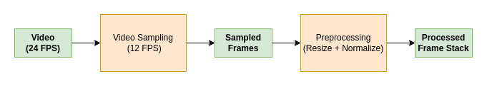
Data preprocessing
A unit action video clip has resolution: 1280x720, Duration: 4 sec's, FPS: 25 fps
For each action clip we employed following preprocessing strategy,
We took alternate frame (by sampling) which results to `50 images`.
Resizing to a resolution of `224x128` followed by normalization have been done to preprocess them.
The dataset distribution of `train : test = 90% : 10%` is been employed while storing.

Slide 7
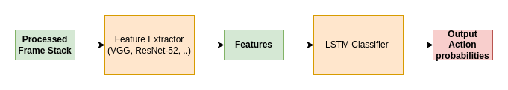
Model building: architecture

Slide 8
Model building: important notes
Throw-in : Corner : Yellow-card = 120 : 120 : 120 clips and can be increased if GPU is powerful enough.
4 sec’s of action video clip at 25 FPS => 50 Frames (12 FPS) are sampled.
Resizing (done according to aspect ratio) followed by normalization is done on the images as preprocessing step.
When training pre-trained ImageNet weights are used for both VGG16 & ResNet52.
Reconversion from frames to timestamp start and end are also being computed along with the predicted event.

Slide 9
Implementation
Checkout entire project's source code in this Github repository for implementation and additional details.

Slide 10
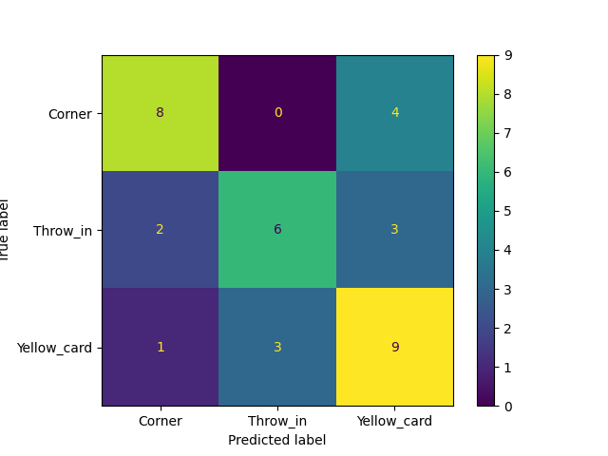
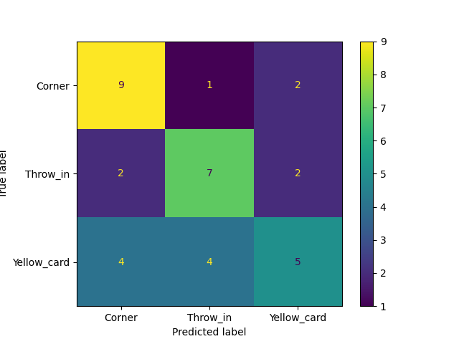
Model building: metrics
VGG backend ResNet-52 backend

Slide 11
Conclusion
Increasing the dataset volume decreased the number of FPs.
The FPs are low when the backend is VGG16 compared to the ResNet52.
The LSTM effect on the output diminishes if the number of hidden units > 128.
Good Confusion matrix metrics with VGG16 backend.
Due to memory and GPU limitations, the overall dataset consists of 360 clips.
Normalizing the images helped in increasing the batch size while training leading to faster training process.

Slide 12
Future aspects
Parallely looked into C3D i.e 3D Conv. Nets, trained on UCF101, ASLAN action recognition datasets.
Late fusion methods can also be experimented.
Combining both audio & video features for the final action prediction can also be explored.

Slide 13
Thank you
VediF: Video-based event detection in Football
Progress Review, 31st Oct
Videoverse and Konverge AI Pvt Ltd

